Slide 1
Education Grows Resilience and Nations
Cisco Networking Academy
January 2025
Notes:
[Slide purpose: thank you, NetAcad purpose, resilient nations]
Thank you for inviting us to hear about Cisco Networking Academy and how we work with strong partnerships through our corporate social responsibility focus to empower all people with career opportunities and for considering how we might partner with you.
Educators have been teaching students to be resilient for many years, inside of 21st Century learning.
But what does this mean for nations and our levels of competitiveness, innovation and protection if we have a resilient mindset, population and workforce?

Slide 2
Growing nations
Human Capital. Education. Resilience.
Moving from systems breakdown to systems breakthrough
Disruption
Secure
Global systemic
problems
Global
innovative solutions
Discontent
Disconnection
Satisfying
Smart
Destruction
Disparity
Sustainable
Shared
Multi-level Resilience: A Human Capital Perspective, June 2019
Notes:
[Slide purpose: The role of human capital in growing resilient nations (GDP) through education and partnerships. Education Grows Nations]
A 2019 Belgian white paper looked at how important human capital is for developing multi-level future resilience at all 3 levels of society: individual, organizational and socio-ecological. The paper establishes that, in order for a breakthrough to occur from a fragmented system (on the left in this diagram) to an innovative one (on the right), RESILIENCE at all 3 levels must exist (3).
We know that the rate of progress in human capital determines the main difference between developed and developing countries and their GDP (gross domestic product). One source states that: “Every skill proficiency percent gained for a country is associated with a US$600 increase in GDP per capita” (1)
So, building human capital is a priority for all nations because it’s fundamental to economic growth through breakthroughs in increased productivity and advancement of technology. (2)
And education is key to empowering economic growth because we know that education builds human capital.
So, whether it’s continuing to skill students or reskilling the existing workforce, we must create partnerships and work together so that we can support people, organizations and nations to find their resilience.
[Sources:
(1) Coursera 2020 Global Skills Index Highlights Urgent Need for Reskilling, Businesswire.com
https://www.businesswire.com/news/home/20200716005224/en/Coursera-2020-Global-Skills-Index-Highlights-Urgent-Need-for-Reskilling
(2) Owlcation, August 2018
https://owlcation.com/social-sciences/ROLE-OF-HUMAN-CAPITAL-IN-ECONOMIC-DEVELOPMENT
(3) Multi-level Resilience: A Human Capital Perspective, June 2019
https://www.researchgate.net/publication/334654531_Multi-level_Resilience_A_Human_Capital_Perspective]

Slide 3
Human capital priorities
Governments and citizens align
Government priorities
Citizen priorities
Digital readiness
(e.g. Cybersecurity)
Zero hunger and poverty, good health/ well-being, clean water and sanitation
Job creation
Job security ⁽¹⁾
Decent work and economic growth
Reducing unemployment
through skills/reskilling/upskilling
Quality education
(1) McKinsey & Company, 7 February, 2020
World Economic Forum and IPSOS, 7 February, 2021
Notes:
[Slide purpose: to show shared values of governments and citizens in human capital priorities. Alignment: job creation, job security, economic growth/reducing unemployment and quality education – all things that we can partner to support]
Building human capital is a top priority for countries and citizens everywhere. We consistently hear that these are the three top government priorities, no matter who we talk to around the world:
Digital readiness (for example, Cybersecurity border protections, preparing citizens and businesses for imposed threats)
Job creation
Reducing unemployment through education – whether that’s skills for students or upskilling existing workforces to navigate the transitions of industries and organizations digitizing
Aligned to the top 3 priorities for each country, job security was the most important citizen economic priority in a McKinsey survey in February 2020, even before the impact of the pandemic (1).
More recently (June 2021), the World Economic Forum and IPSOS surveyed 20,000 people in 28 countries to rank the UN Sustainable Development Goals. After expected base needs of zero hunger, no poverty, good health and well-being, the next top 3 citizen priorities were:
clean water and sanitation
decent work and economic growth, and
quality education. (2)
So governments and citizens are aligning on what is important in terms of human capital development and which areas require collective resiliency:
job creation, job security, economic growth/reducing unemployment and quality education.
[Sources:
(1) A government blueprint to adapt the ecosystem to the future of work, McKinsey & Company, February 7, 2020
- 100,000 people surveyed by McKinsey in almost 30 countries
(2) Global public ranks ending hunger and poverty and ensuring healthy lives as top priorities among U.N. SDGs, June 9, 2021
https://www.ipsos.com/en/global-public-ranks-ending-hunger-and-poverty-and-ensuring-healthy-lives-top-priorities-among-un ]

Slide 4








Cisco Digital Readiness Index
Explores country readiness for
a digitized future for planning
Links to gross domestic product per capita
Total digital readiness score
Basic needs
Business and government investment
Ease of doing business
Explore now
Human capital
Start-up environment
Technology adoption
Technology infrastructure
Notes:
[Slide purpose: to show NetAcad tie-in with digital readiness priority]
And so from a digital readiness (or digital resiliency) perspective, we developed an index that explores how ready 141 countries are for a digitised future.
We did this because research found a relationship between the digital readiness of a country and gross domestic product (GDP) per capita demonstrating the importance of economic value and digital readiness.
This is a great tool for our partners to use to help with their investment decisions to be a future-ready economy.
The index covers 7 components, with “Human Capital” rated on:
Literacy Rate
Education Index (Years of Schooling)
Labor Force Participation
Harmonized Test Scores
[TAKE A MOMENT TO EXPLORE https://www.cisco.com/c/en/us/about/csr/research-resources/digital-readiness.html]

Slide 5





Job creation
Tech skills shortfalls continue
Software engineer
jobs growing
3+ times the average by 2026
60%
104%
65%
Cybersecurity
jobs growing
31% by 2029, 7+ times the average
Basic and advanced
programming
Connected
Technologies growing
of CIOs plan to deploy advanced network solutions
Notes:
[Slide purpose: to show NetAcad tie-in with job creation priority]
Even though 65% of CIOs are planning to deploy advanced network solutions, shortfalls in technology jobs continue.
Here are some of the other tech skills shortfalls and corresponding job opportunities.
Sources: CNBC
Bureau of Labor Statistics' Information Security Analyst's Outlook
*Skills of Mass Disruption: Pinpointing the 10 Most Disruptive Skills in Tech, Burning Glass Technologies, 2020
Cisco Global Networking Trends Survey
The IT landscape is rapidly evolving.
https://www.cisco.com/c/dam/en/us/solutions/collateral/enterprise-networks/digital-network-architecture/global-nw-trends-survey.pdf
The A.I. Paradox: How Robots Will Make Work More Human, Oxford Economics and Cisco, December 2017

Slide 6
Job creation and job security
9 out of 10 IT jobs are now outside the tech industry
Oracle Academy and Burning
Glass Technologies
Notes:
[Slide purpose: to show NetAcad relevance to job creation & job security – tech/digital skills]
The pandemic-influenced rise of the hybrid workplace along with accelerated digitization has created unprecented job opportunities in technology and digital skills across all industries.
For example, Cisco customers are demanding digital delivery across all industries, in four main areas: Applications, Hybrid Work, Reducing Complexities of Infrastructure, and Securing Enterprises
It’s been estimated that 75% of companies have decided to accelerate their transformation plans because of the pandemic, (1) with almost the same amount of CIOs reporting that digital projects that would have taken a year to be approved, are now being approved in a matter of weeks. (2)
But even before this, we were seeing technology and digital skills gaps for individuals, organizations and countries, with 9 out of 10 IT jobs outside of the traditional tech industry, for example in professional and financial services, manufacturing, and utilities. (4)
The Future of Work requires more digital skills and organizations need people with greater skills to support these shifts as industries and organizations continue to digitize and re-invent themselves.
Upskilling with the right digital skills, individuals can prepare for the Future of Work and take advantage of job growth opportunities that are available right now and into the future!
[MORE]
At Cisco, we had customers wanting to deliver anything that could be delivered digitally, across these four key areas:
Applications moving from an being an extension to the business to BEING the business, so CIOS are re-imagining how they design, develop, and deploy their applications for service delivery and service consumption
Powering hybrid work, needing to use the most reliable, secure, productive technology to empower their teams for every scenario
Reducing complexity of their infrastructure with 29 billion devices connecting to the internet by 2023 and placing strain on the network. All devices need to be monitored in real-time, policies created and deployed in an automated way, so CIOs are thinking about how they transform their infrastructure with the network at its core.
Securing enterprises with remote work expanding the attack surface exponentially.
[Source:
(1) Fortune 500CEOsurvey: How are America’s biggest companies dealing with the coronaviruspandemic? [14May2020]
(2) AppDynamics The Agents of Transformation Report [26May2020]
(3) THE RISE OF THE HYBRID WORKPLACE, A Global Survey of Executives, Employee Experience Experts, and Knowledge Workers, Dimensional Research sponsored by Cisco, October 2020
https://www.cisco.com/c/dam/en/us/products/collateral/collaboration-endpoints/global-workforce-survey.pdf
(4) Beyond Tech, The Rising Demand for IT Skills in Non-Tech Industries, August 2019
https://www.burning-glass.com/research-project/beyond-tech/

Slide 7





Reducing unemployment by developing skills for real jobs
Networking
Cybersecurity
AI & Data Science
Programming
Information Technology
C97-2556358-00 © 2025 Cisco and/or its affiliates. All rights reserved. Cisco Public
Notes:
[Slide purpose: to show NetAcad tie-in with reducing unemployment priority – 3 main skills to jobs pathways.]
One of the exciting developments that this tech skills gap is creating, is broader job opportunities for entry-level jobs in non-tech industries that don’t necessarily require degrees or extensive work experience.
So learners can enter technology jobs through a variety of pathways now and we’ll go through this a little deeper in a moment but the main technology skills to jobs pathways are in programming, IT support, and Cybersecurity.
[More]
Entry-Level IT Jobs in Non-Tech Industries Are More Accessible
Non-tech industries are less-likely to require experience for entry-level IT jobs in non-tech industries
This makes them more accessible, requiring only 0 – 2 years’ experience compared with the 85 percent of IT jobs that require a degree
IT jobs pay substantially more
No matter which industry, by at least $20,000 a year.
“An IT worker will earn 600% more than a worker receiving the minimum wage”
(Beyond Tech: The Rising Demand for IT Skills in Non-Tech Industries, Oracle and Burning Glass Technologies, August 2019)
(Beyond Tech: The Rising Demand for IT Skills in Non-Tech Industries, Oracle and Burning Glass Technologies, August 2019)

Slide 8
Human capital
Building capacity for resilience
Skilling-Reskilling
(1st + 2nd Industrial revolutions)
Upskilling
(3rd Industrial revolution)
Human capital
(4th Industrial revolution)
Q
Q
Q
Q
Q
Q
Q
A
A
Q
A
A
A
A
A
Competence
Capable
Capacity
Perform to benchmark level
Translate competence
to new challenge
Find + frame new challenges
Draw on existing knowledge
Translate + deepen existing knowledge
Formulate new knowledge
“We have the opportunity to reach out and elevate different parts of the world, tap into talent, and provide education to places in the world that didn’t have those options before. And that’s better for all humanity.”
– Heather McGowan, Futurist and Education Speaker
Source: https://newsroom.cisco.com/feature-content?type=webcontent&articleId=2169606
Notes:
[Slide purpose: Expansion of Education to build capacity in human capital]
The way that we can address this skills shortfall and create job security is through human capital development.
Together, and in partnership, we have the opportunity to help countries to tap into their talent base and make education available to people who may not have had the ability to access quality education for whatever reason in the past.
It’s better for the individual and their families, it’s better for the community, and it’s better for the nation as education is tied to GDP growth.
So as Futurist and Education Speaker Heather McGowan says: “And that’s better for all humanity”
[PAUSE]
Sources:
https://newsroom.cisco.com/feature-content?type=webcontent&articleId=2169606

Slide 9

Empowering all people with career possibilities
Our purpose
C97-2556358-00 © 2025 Cisco and/or its affiliates. All rights reserved. Cisco Public
Notes:
[Slide purpose: Cisco Networking Academy vision – CSR focus]
And so our vision at Cisco Networking Academy is to empower all people with career possibilities by transforming the lives of learners, educators, and communities through the power of technology, education and career opportunities.
We offer inclusive access across the globe, bring our best-in-class standards, and educate for today and tomorrow by teaching new skills, reskilling, and upskilling for the jobs of the future.
We bring it all together for the learner—providing a clear skills-to-jobs pathway—with powerful partnerships who really know education and share Cisco’s commitment to create an inclusive future for all.

Slide 10
Cisco Networking Academy
One of the world’s longest-standing IT skills-to-jobs programs,
designed by Cisco to help bridge digital skills gaps
Partners
Cisco
Instructors
Educational Institutions*
National/local governments
Corporations
NGOs*
Choose course offerings, decide if certification or degree program
Provide instructors and buildings
Curriculum and Webex licensed free*, instructor training, assessments, discounted equipment, online delivery,
support, job-matching engine
(650+ employers)
Conduct classes
Administer hands-on labs and skills assessments
Students – skills to jobs success
Notes:
[Slide purpose: The only way to make this work is by coming together in partnerships.]
All of our achievements over the past 24 years have resulted from strong partnerships across all sectors: governments, educational institutions, private sector, businesses, and NGOs.
Powering an inclusive future for all is not just a call to action. It’s recognizing that it’s going to take all of us.
If we can come together as a community – Cisco, our customers, our partners, other like-minded organizations, even those that might be seen as competitors – we CAN make a difference. So, join us, and let’s create this inclusive future, together.
[More]
Cisco Networking Academy takes a unique approach to delivering its IT skills education. It is an ecosystem comprised of partners coming from educational institutions locally, plus national and local government, corporations, and NGOs.
Cisco provides the curricula, instructor training, assessments, and at-cost equipment. The schools and other partners provide building space and instructors.
Networking Academy maintains control of the course content, manages online delivery and assessments, and offers support and discounted equipment.
Local educational institutions, governments, and other organizations choose which courses to offer and determine the context in which the courses are to be delivered, such as making them part of a certification or degree program.
Instructors receive course-specific teacher training from Cisco, conduct the classes, and administer hands-on lab activities and skills assessments.
Networking Academy aims to ensure that students and instructors have the resources they need to accomplish their goals.

Slide 11

Hybrid learning
New types of learners
In the classroom, at home, or a part of an existing workforce needing to be reskilled
Behaviors are changing
Meet learners where they are
with flexible options
Education delivery is expanding
Expand access to learners everywhere
C97-2556358-00 © 2025 Cisco and/or its affiliates. All rights reserved. Cisco Public
Notes:
[Slide purpose: Education disrupted – what do shifts mean for the sector?]
Education has been changing for many years now, but the global pandemic accelerated the disruption.
Adapting to hybrid learning
We need to be able to meet learners where they are at.
We need to meet learners and new types of learners, where they are, whether they are in the classroom, at home, or a part of an existing workforce needing to be reskilled.
Types of learners and their behaviours are changing
Learning never stops! Learning is ongoing and on the go!
And the type of learner is changing – as learning becomes a life-long adventure – and our education models become more adventurous.
For example, we need to provide skills content in smaller, more digestible bits to allow for learners to engage with the content as they can, on the go, and at a time that suits them. Again, meeting learners where they are at.
Education delivery is expanding and changing
So, we need to find ways to expand learner access everywhere, anytime, any place, and in flexible chunks – large and small.

Slide 12

Reimagining education
20 million more learners
over the next 5 years
C97-2556358-00 © 2025 Cisco and/or its affiliates. All rights reserved. Cisco Public
Notes:
[Slide purpose: What’s next for NetAcad?]
We are being adventurous and reimagining education—fast—challenging ourselves and our ecosystem of partners to aspire to engage 20 million more learners over the next five years.
We are evolving our education model because as we’ve seen, learning never stops!

Slide 13

Our Impact
As Certain as Cisco
12,100 academies in
180 countries, up to
27 languages
24 million learners, globally
96%
Cisco’s
largest social investment, changing the lives of learners everywhere
for 27 years
96 percent
obtained a job or education opportunity*
2.9 million learners attribute jobs to NetAcad skills learned
27 percent current female participation
90,662 people with diverse abilities gained skills (since 2019)
Curricula and WebEx
licensed free to educational and non-profit institutions**
USD 5.7 billion
in-kind contributions
Global figures released end July 2021
*Students who completed a Cisco certification ready course
**Conditions apply
C97-2556358-00 © 2025 Cisco and/or its affiliates. All rights reserved. Cisco Public
Notes:
[Slide purpose: Our global impact – https://www.netacad.com/about-networking-academy/global-impact]
We’re the largest and longest running corporate social responsibility education program in the world and we’re really proud of the impact we make, especially with under-resourced and under-represented people in our communities.
We operate in up to 27 languages across 180 countries in 12 thousand academies around the world.
We’ve trained more than 24 million learners; 2.9 million of whom attribute jobs to Networking Academy
And most importantly, we connect real people to real jobs in the marketplace.
So in this way, it’s a true skills-to-jobs program.
95 percent globally either go onto higher education or get a job of students who complete a Cisco certification ready course.
We currently have a female participation rate of 27 percent, 25 percent since inception – we’re excited to see this going up.
We’ve provided education opportunities to over 90 thousand people (90,662) who have declared disabilities since 2019.
With curricula (tools, delivery platform, assessment engine) licensed free to educational and non-profit institutions as well.
In-kind contributions since program inception (5.7 billion – FY21 global figure, since inception)
[More]
Instructors: 29,300
Total Support & Training Partners: 1,117 (ASC = 550; ITC = 567)
Instructor Impact: 93.1% instructors said Networking Academy helped them be a better educator from Instructor & Partner Survey

Slide 14

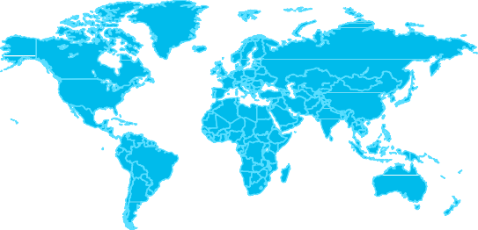


























Global Impact Report
empower through technology, elevate through education
Current annual students from selected countries
Students
Peru: 332,790
India: 688,901
USA: 316,789
Italy: 79,169
Brazil: 212,533
Mexico: 189,934
4,667,000
current annual students
24,171,000
total students since inception
27%
are female since inception
based on those who identified gender
Nigeria: 243,145
South Africa: 154,056
Philippines: 132,806
Germany: 68,293
Pakistan: 154,569
UK: 89,121
+179 more countries
Public-Private Partnerships
Instructors
Cisco Academies
In-Kind Contributions
749 Academy Support Centers and Instructor Training Centers
Global partnerships
International Telecommunication Union
(UN-ITU)
United Nations Educational, Scientific and Cultural Organization (UNESCO)
Unicef
Global Partnership for Education (GPE)
Anglo American
United States (U.S.) State Department
SOS Children's Villages
African Child Projects
Deutsche Gesellschaft für Internationale Zusammenarbeit (GIZ)
$5.7B USD
since inception, in curriculum, tools, resources, and support to students, schools and instructors
Government partnership examples
White House Cyber Education and Workforce Commitment
Ministries of Education in Argentina, Chile, China, Colombia, Costa Rica, Ecuador, Egypt, Germany, Italy, Israel, Mexico, Morocco, Nigeria, Peru, Spain, Turkey and UAE
Additional partnerships with Ministries around the world: Communication and Information Technology (ICT), Defense, Digital Innovation and Interior Affairs, Economy, Justice, Industry, Labor Skill Development and Entrepreneurship
31,300
active instructors
23%
are female
based on those who identified gender
12,100
institutions and organizations offering Networking Academy courses
Jobs
Cisco Networking Academy is a skills-to-jobs program offering technology education through public-private partnerships, high-quality curriculum, and inclusive workforce development programs.
96%
students who completed Cisco certification-eligible courses obtained a career and/or educational opportunity based on surveys since fiscal 2005 through fiscal 2024
Networking Academy leverages public-private partnerships with governments, academic institutions, NGOs, and nonprofit organizations to help students from virtually every socioeconomic background develop the skills needed to design, build, secure, and maintain computer networks
*Inception 1997
*In-kind contributions and metrics as of Cisco fiscal
Notes:
[Slide purpose: Our Impact by country/region - https://www.netacad.com/about-networking-academy/global-impact]
https://cisco.sharepoint.com/sites/NetAcad/SitePages/NetAcad-Infographics-by-Region.aspx

Slide 15
Public-Private partnerships make it work
Government
Public benefit
(NGOs)
Education
Business
Together we can ensure student success
C97-2556358-00 © 2025 Cisco and/or its affiliates. All rights reserved. Cisco Public
Notes:
[Slide purpose: restate the importance of partnerships]
All of our achievements over the past 24 years have resulted from strong partnerships across all sectors: governments, educational institutions, private sector, businesses, NGOs.
With a shared collective value on student success – because powering an inclusive future for all is going to take all of us.

Slide 16
Student value – Skills to jobs
Jump-start careers
Curated learning paths aligned to job roles and certifications
Alumni connect
Alumni network on LinkedIn
Global peers and instructors
Comprehensive subject areas, including Cybersecurity, Networking, AI, and Programming
Easy starting points
Flexible learning: at your own pace or find instructor-led courses
Career boost
Introductory courses with no prerequisites
Free self-paced courses - learn at your own pace
Explore careers in tech and IT
Career resources for job seekers
Workshops, resume and interview practice, and more
Connections to job opportunities through Cisco and our partners
Curated job board hub through Indeed
Stand out
Digital badges and certifications validate skills to employers and social networks
Notes:
[Slide purpose: student value of program]
So, of course, this is all relevant if students see the value, too!
We offer a complete END TO END Skills to Jobs program. With in-demand skills for in-demand jobs.
Students have the courses, tools, resources, and connections to help them jumpstart their career.
[MORE DETAIL]
Easy starting points
For learners who are just getting started, we offer easy ways to explore the field of tech. Whether their aim is to pick a career direction or simply be a tech-informed citizen in the digital world, we have flexible introductory courses for anyone - no prerequisites needed.
Jump-start careers: In-demand skills for in-demand jobs
We offer curated learning pathways for learners, starting at the entry-level with no prior knowledge.
Curriculum is designed based on job-task analysis and aligned to industry-recognized certifications to ensure students are learning relevant, in-demand skills.
Our comprehensive learning portfolio covers key subject areas, such as Cybersecurity, Networking, AI & Data Science, Programming, Digital Literacy, Professional Skills, and even resources on Sustainability.
Our free teaching & learning platform is designed with innovative learning features, including built-in adaptive learning, gamification, interactive activities and learning widgets, practice labs, and assessments to emphasize a learning-by-doing approach.
Educational institutions and organizations can leverage the curriculum and teaching platform at no cost to enhance their degree, vocational, or educational programs.
NetAcad graduates stand out from the crowd
Learners earn digital badges to verify their knowledge to employers and their networks
99% of organizations use technical certifications to make hiring decisions ¹
Our curriculum aligns to 18+ certifications.
Earning industry-recognized certifications gives learners true credibility in the market.
Alumni Connect
Connects peers and instructors around the world through our LinkedIn community.
Students immediately belong to a global, inclusive community
Our ecosystem of partners and instructors empowers a global community that learns and grows together
We give their career a boost
Learners get access to career resources to build their job-seeking skills and materials, like workshops, resume writing, and interview prep
We help connect learners with real job opportunities through Cisco and our network of partners
We are cultivating employment partnerships locally and globally
In 2024, we launched a partnership with Indeed to create a curated job board hub especially for Cisco Networking Academy learners. (*Pilot for U.S. jobs available now, and we are exploring expansion into additional countries/regions).
Sources:
(1) 2020 IT Skills and Salary Report, Global Knowledge ¹
(2) "By 2025, 72% of all internet users will solely use smartphones to access the web” Source: https://www.bankmycell.com/blog/how-many-phones-are-in-the-world

Slide 17


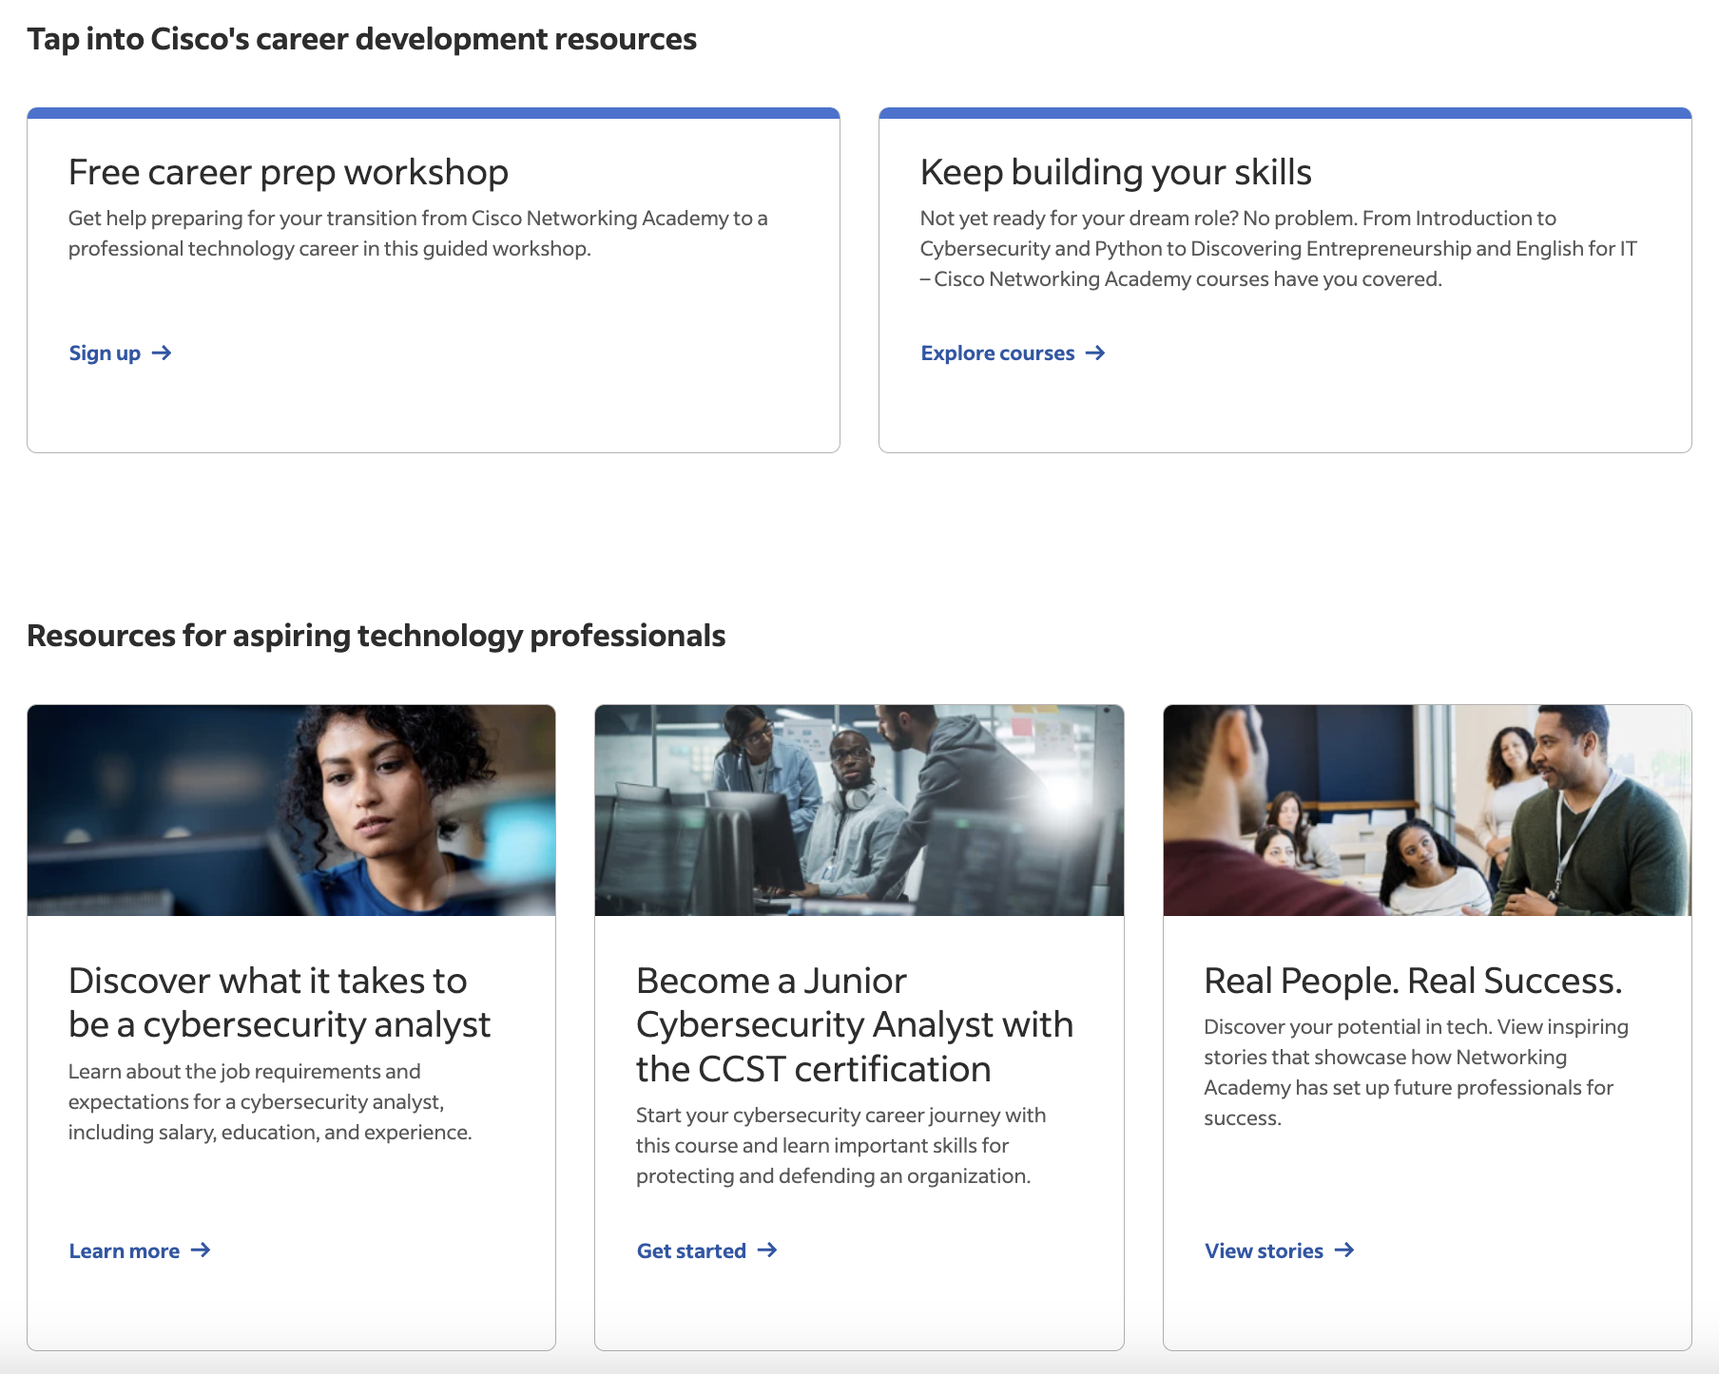
Indeed + Cisco Networking Academy Career Hub
Find Jobs
Career Preparation Services
Career Development Resources
Open IT jobs from highly rated employers in the US
Jobs aligned to skills learned through NetAcad curricula ​
Free and discounted career preparation services*
  Resume writing
  Career coaching,
  Mock interview and offer negotiation prep services
Access to Career Prep Workshop on netacad.com
Information and access to in-demand courses and skill-building resources
https://www.indeed.com/netacad
[1] Select Career Services require payment​
[2] Limit one free service per Indeed Account. A free Indeed account is required to receive a discount. Offer available while supplies last. Offer expires August 23,2025​
[3] Based on survey responses from 2005 through fiscal year 2022 of students who took Cisco certification-aligned courses. 2. IT Skills & Salary Report, 17th Edition. 3. 2023 Pearson VUE Value of IT Certification
Notes:
https://www.indeed.com/netacad

Slide 18

The Certification Advantage
99% of organizations use technical certifications to make hiring decisions.¹
Validates skills
Cisco-certified community
Job-readiness
More earning
potential
Tech Manager Readout, Cisco and Illuminas, October 2019
C97-2556358-00 © 2025 Cisco and/or its affiliates. All rights reserved. Cisco Public
Notes:
[Slide purpose: the advantage of certifications]
Students earn digital badges and certifications along their learning journeys, and learning pathways map to career pathways.
Certifications count, with 99% of organizations using technical certifications to make their hiring decisions. (1)
Validated skills
97% of organizations offer recognition and incentives for employees earning technical certifications (1)
And it’s now a large community with so many Cisco-certified people, globally.
Job Readiness
71% of hiring managers say that certification increases their confidence in an applicant’s abilities (3)
More earning potential
IT professionals who gained new skills or certifications last year received an average salary raise of $12-13,000 (2)
Sources:
1. Tech Manager Readout Cisco and Illuminas, October 2019
2. 2020 IT Skills and Salary Report, Global Knowledge
3. 2018 IDC Worldwide IT Employment Model Future of IT Survey
[More on why certifications are important
https://www.cisco.com/c/en/us/training-events/training-certifications/why-certify.html
https://www.cisco.com/c/dam/en_us/training-events/certifications/get-certified.pdf
https://www.networkworld.com/article/3625579/cisco-ccna-certification-explained.html
https://www.usnews.com/education/cisco-certification-guide ]

Slide 19



Skills to Jobs – Top skills employers want
Networking and Software
Cybersecurity
AI & Data Science
Professional Skills
Network architecture and design
Data center
Network management
App development
Software programming and development
Network security
Cloud security
AI security
Risk management
Incident response
Generative AI
Responsible AI & ethics
Data science
Data visualization
Business analytics
Communication
Critical thinking
Problem solving
Self-Management
Adaptability
Creativity
Notes:
[Slide purpose: Demonstrating our skills-to-jobs approach for students to gain relevant, in-demand skills]
We develop our curriculum based on job-task analysis and alignment with industry-recognized certifications.
And we continue to add and enhance our portfolio of learning offerings as industry evolves.
Here are some of the top key skills employers are looking for in job candidates.

Slide 20



Developing well-rounded job candidates
What they learn
How they learn
How they think
Technical skills
Practice
Professional skills
Networking
Cybersecurity
AI & Data Science
IT
Programming
Digital Literacy
Learning by doing
Virtual and physical labs
Interactive activities and widgets
Formative & summative assessments
Collaboration tools
Problem solving
Communication
Teamwork
Adaptability
Critical thinking
Ethics and responsibility
Entrepreneurship
and more
Notes:
[Slide purpose: we teach more than just IT skills]
Cisco Networking Academy teaches more than just IT skills… to help students with their future.
In addition to teaching the most current technology skills,
we also teach skills for the future workplace and entrepreneurial skills, such as attitude and mindset, helping them to not only get jobs but create jobs.

Slide 21
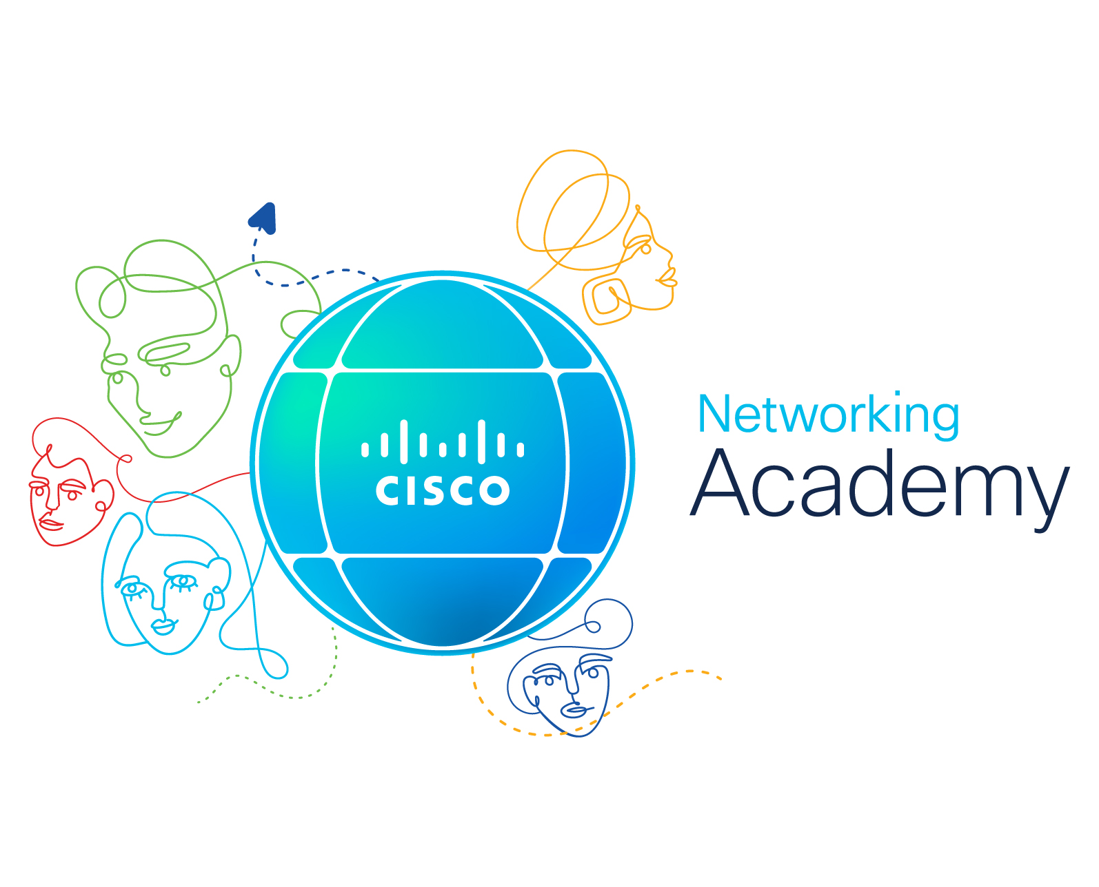





Empowering all people with career possibilities
Career Resources
Learning
Practice
Credentials
Top Jobs
+
+
+
=
Cisco Networking Academy offers top-notch, practical curriculum
designed with the end in mind: the skills required for success in a job role.

Slide 22

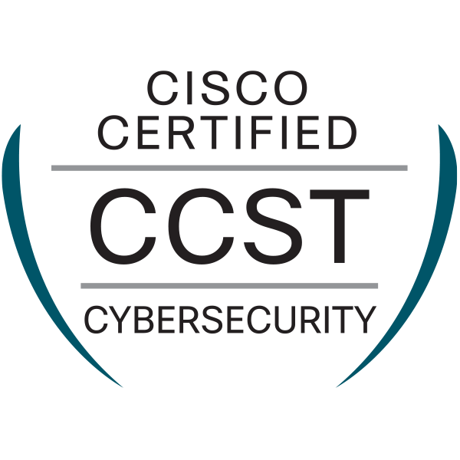
Industry-recognized credentials to verify skills
Digital Badges
Certifications
Most Cisco Networking Academy courses or career paths include a digital badge.
These digital credentials verify that a learner has successfully completed the criteria to earn the badge.
Digital badges issued by Cisco are completely free and easy to share on a resume, website, or social media.
The Cisco Networking Academy portfolio prepares learners for industry certifications in cybersecurity, networking, programming, and even English for IT.
With progression paths starting from entry-level, learners get clear achievable milestones to help them get started and grow their tech career.
Exam discounts are available for select certifications for qualifying Cisco Networking Academy students.

Slide 23
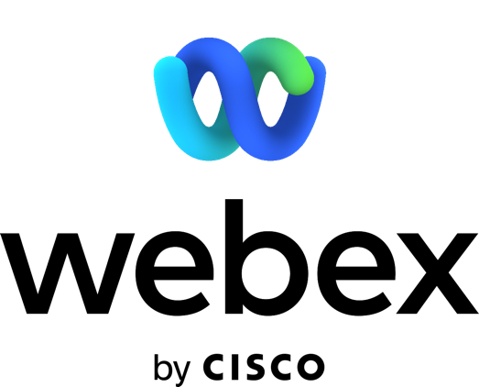
Partner value
Cisco Networking Academy
Leading-edge*
content
Brand association*
Cisco and NetAcad
Recognition*
from government/peers
Continuous
professional development
Collaboration
across ecosystem
Future student pipeline
for your institution
CSR Alignment NetAcad mission and social impact
Jobs connection
Free NetAcad
account more benefits
*most valued by Partners
Notes:
[Slide purpose: for PROSPECTIVE PARTNERS, to highlight key partner-valued aspects of the program. Top 3 most valued by partners: content, brand association, recognition by government and peers]
We hear from our Partners all the time about the benefits or value to them in partnering with NetAcad.
Whether it’s the association with the Cisco brand or the access to the best and most up-to-date content for students in the classroom or wherever they are, or the leadership and recognition you might get in your country, these are what our Partners say to us about the value they get from our partnership.
[PAUSE – OR GO THROUGH AREAS OF INTEREST WITH AUDIENCE]
[More on NetAcad Webex accounts – see next slide]

Slide 24
Free account
NetAcad account
1 Host
50 minutes duration
Up to 100 participants
Unlimited Co-Hosts
24 hours max duration
Up to 1000 participants
50GB Cloud recording storage
MP4 recordings
Recording transcripts
File transfer feature
Access to Meeting, Events and Training Center
Notes:
More on NetAcad Webex accounts
Free Account
1 Host
50 minutes duration
Up to 100 participants
NetAcad Account
Unlimited Co-Hosts
24 hours max duration
Up to 1000 participants
50GB Cloud recording storage
MP4 recordings
Recording transcripts
File transfer feature
Access to Meeting, Events and Training Center

Slide 25
Begins with our instructors
Video
Notes:
[Slide purpose: instructor audience]
[PLAY VIDEO]
https://vimeo.com/veritasevents/review/329244463/ac1be42d5a

Slide 26

Cisco Networking Academy At-A-Glance
Current and Continuous
Convenient
Curriculum kept current;
delivered over a cloud-based, custom learning platform
Career
Matches grads to jobs with
talent-matching engine
Flexible online course delivery:
instructor-led and self-paced
Custom Content
Career Development
Ongoing instructor professional development, badging, industry certifications and recognition
Impactful curriculum to personalize learning experience; multi-language options, assessment and simulation tools, aligns to industry certifications
A Cisco corporate social responsibility education program
Developed by Cisco to help fill digital skills gap
Curriculum and Webex licensed free to educational and non-profit institutions
C97-2556358-00 © 2025 Cisco and/or its affiliates. All rights reserved. Cisco Public
Notes:
[Slide purpose: at-a-glance for instructor audience]
A Cisco CSR education program, developed by Cisco to help fill the digital skills gap.
Curriculum and Webex licensed free to educational and no-profit institutions.
Current and continuous curriculum, delivered over a cloud-based custom learning platform
Convenient – with flexible online course delivery (instructor-led and self-paced)
Custom content – impactful curriculum to personalize learning experience, multi-language options, assessment and simulation tools, aligns to industry certifications
Career development – ongoing instructor professional development, badging, industry certifications and recognition

Slide 27
Hybrid learning
8 best-in-class tools
1
Teaching & learning platform
Free NetAcad
Webex accounts
5
2
Instructor Professional Development
Cisco
Packet Tracer
6
3
Additional teaching resources & materials
Flexible, self-paced courses
7
8 Tools for hybrid learning
4
Instructor Facebook communities
Combines instructor-led and online learning
8
Learn more
Notes:
[Slide purpose: instructor audience – Hybrid learning tools with NetAcad]
Hybrid learning is an educational model where some students attend class in-person, while others join the class virtually from home. Educators teach remote and in-person students at the same time using tools like WebEx, NetAcad courses and packet tracer
A comprehensive teaching platform, netacad.com, that allows you to manage your courses and administration
Online professional development, including webinars, presentations, and trainings
Content to meet the needs of all students, including videos, labs, quizzes, and other activities
Instructors Facebook page, an active community where instructors ask questions, give advice, and share their knowledge and best practices
Free WebEx accounts so you can stay connected with your students
Cisco Packet Tracer, an innovative virtual network simulator that allows students to configure, troubleshoot, and set up networks – all online
[Jeremy Creech video https://www.facebook.com/watch/?v=838469453522486 ]
Short online courses that allow students to explore critical subjects like cybersecurity, IoT, and Python that supplement the larger curriculum
Combines the best of instructor-led and online learning to create a best-in-class hybrid learning experience.

Slide 28
Instructor value
Cisco Networking Academy
Professional development
Leading-edge content
Skills to jobs program
Enabling hybrid learning
Free Cisco Webex NetAcad Account
Online cloud delivery
Student Hands-On Labs
discounted rates
Industry-leading
simulation tools
– Packet Tracer
Certifications aligned
Career pathways
Talent Bridge job-matching engine
Notes:
[Slide purpose: NetAcad value for instructors]
In terms of their own personal benefits, the majority of NetAcad instructors tell us that Networking Academy has helped them to become a better educator through continuous professional development.
They say that it has had a positive impact on their community and their life, broadened their careers, and helped them develop professional relationships.
Access to instructor professional development content and opportunities through our extensive Partner ecosystem
We partner and enable you with the transition to hybrid learning without compromising curriculum quality or learning science principles
By offering FREE Cisco Webex NetAcad accounts with more added benefits [see below for detail] and Online Cloud delivery
Access to Curriculum Content that is comprehensive, brand-agnostic and delivered over Cloud – so content is current immediately.
Continuously updated curriculum content for students that is aligned to industry certifications and job skills requirements
Access to continuously updated assessments for students
Providing students with access to hands on labs (at discounted rates) as well as industry leading simulation tools such as Packet Tracer to apply theoretical knowledge in a practical way.
Alignment with industry leaders such as Cisco and local partners

Slide 29
Teach with us!
NetAcad.com/educators
Notes:
[Slide purpose: call to action]
Leverage the Cisco brand to GROW ENROLLMENT in your technical programs
As the leader in networking technology, you benefit from our expertise and global recognition. Partnered with us, you are on the cutting edge of industry breakthroughs on knowledge and network. https://www.netacad.com/educators/get-started
Six Easy Steps to becoming a Cisco Networking Academy
How to Become an Academy
1. Choose your courses
Create the ideal pathway for your institution.
Explore Pathways
2. Get agreement
Bring your administrative and instructor team together to gain agreement.
Download Overview Presentation
3. Apply
Qualifying institutions will be contacted.
Apply Now
4. Train instructors
Instructor Training Centers can help with training, if needed.
Locate Trainer
5. Obtain equipment
Academy Support Centers can help you obtain equipment, if needed.
View Equipment List
6. Create and launch first course
Here’s the fun part! Launch the course and see the students come!

Slide 30
Building Tomorrow’s Workforce, Today

Slide 31

Remote learning
Stephanie teaches all of her nearly 100 students each year online. She shares some tips and tricks she's learned as an online educator.
Get students together in an online classroom or platform so they can interact with each other and use videos, tools, and interesting articles to drive conversations that facilitate learning.
- Stephanie Harvey
Notes:
Teaching tomorrow’s workforce is a tough assignment, but not so when partnering with Cisco. We make it easy to make a difference. Not only does Networking Academy provide cutting-edge courses and reliable assessments, but great flexibility too. All courseware and professional development are available on the robust and scalable netacad.com platform. Allowing you to teach from wherever you are.

Slide 32

Impacting lives
The pressure to fill open cybersecurity jobs is increasing. Gustavo Salazar is going above and beyond to share his cybersecurity knowledge with as many people as possible.
I wanted to become a doctor. I'm a different kind
of doctor — a doctor of technology.
I still get to help people. I help people with their knowledge instead of their health.
- Gustavo Salazar
Notes:
Teaching tomorrow’s workforce is a tough assignment, but not so when partnering with Cisco. We make it easy to make a difference. Not only does Networking Academy provide cutting-edge courses and reliable assessments, but great flexibility too. All courseware and professional development are available on the robust and scalable netacad.com platform. Allowing you to teach from wherever you are.

Slide 33

Reskilling
Megan Chapman details her journey from student at Stanly Community College to
IT professional, crediting the Cisco's Networking Academy program.
Cisco Networking Academy is very important if you are out of school for a long time and you want to go back and pursue a career in networking. It’s a
well-rounded program and it’s very important for
all students that are going to take this path to go through it.
- Megan Chapman
Notes:
Teaching tomorrow’s workforce is a tough assignment, but not so when partnering with Cisco. We make it easy to make a difference. Not only does Networking Academy provide cutting-edge courses and reliable assessments, but great flexibility too. All courseware and professional development are available on the robust and scalable netacad.com platform. Allowing you to teach from wherever you are.

Slide 34

A Taste of Success
When the opportunity to take a Cisco Networking Academy course arose in his
junior year, Allen Chen gave it a try. Today,
he considers that decision the keystone of
his career.
A really important thing with Networking Academy is to build relationships with professionals in the industry. When I was officially in the workforce, I had a lot of contacts that already knew me through other people, which was outstanding. Having those relationships is a key piece to career success
- Allen Chen
Notes:
Teaching tomorrow’s workforce is a tough assignment, but not so when partnering with Cisco. We make it easy to make a difference. Not only does Networking Academy provide cutting-edge courses and reliable assessments, but great flexibility too. All courseware and professional development are available on the robust and scalable netacad.com platform. Allowing you to teach from wherever you are.

